Slide 1

Bike Sharing Demand Analysis Project
Impact of Hour, Weather, and Temperature on Rentals
Name: Swati Maurya
Date: 25-Marach-2026
Internship: NextHikes IT Solutions

Slide 2
Content
Introduction
Problem Statement
Dataset Description
Actions on Data
Cleaning & Merging
Analysis & Statistics (Correlation, Std Dev)
Visualization & Dashboard
Business Recommendations

Slide 3
Introduction
Bike-sharing data provides insights on demand patterns
Analysis helps optimize bike availability and business planning
Data collected hourly/daily, including weather and user info

Slide 4
Problem Statement
Understand how time , weather, weekdays and weathersit affect rentals
Identify trends to improve decision making
Prepare interactive dashboard for management insights

Slide 5
Datasets Description
Dataset Overview
3 datasets Dataset1,Dataset2 and Dataset 3 were given
Dataset 1 includes
Dataset2 includes
Dataset 3 includes
instant | dteday | season | yr | mnth | hr | holiday | weekday | weathersit | temp
Unnamed: 0 | instant | atemp | hum | windspeed | casual | registered | cnt
instant | dteday | season | yr | mnth | hr | holiday | weekday | weathersit | temp | atemp | hum | windspeed | casual | registered | cnt

Slide 6
Actions performed on Data
Data Cleaning
Steps done in data cleaning
Removed duplicates , corrected datatypes
Handling missing values
Data formatting on table names, alignment done on table
Sorting and filtering done
Conditional formatting done on data

Slide 7
Data merging
Steps done in Data merging
Power Query was used to merged and append the datasets into a final dataset
Dataset1 and Dataset2 were merged using power query and the merged dataset we got was appended using power query with Dataset 3

Slide 8
Analysis and Statistics
Calculated average , count, correlation and standard deviation for key columns(temp , casual ,registered , count, humidity)
Created pivot tables to analye rentals by hour , user type , weather and temperature
Conditional formatting used to highlight data ranges high , low and medium
Screenshots for all the charts are provided in the next slide

Slide 9
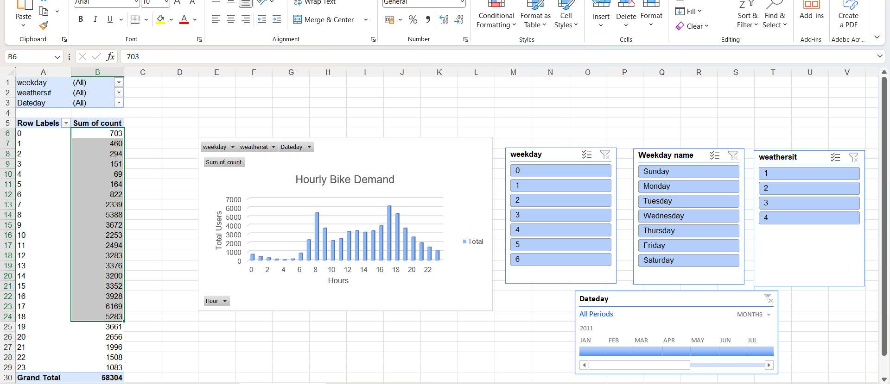
Hourly bike demand
It shows how many bikes are rented each hour of the day
We see peaks around 7-9 AM and 5-7 PM indicating morning and evening demand

Slide 10
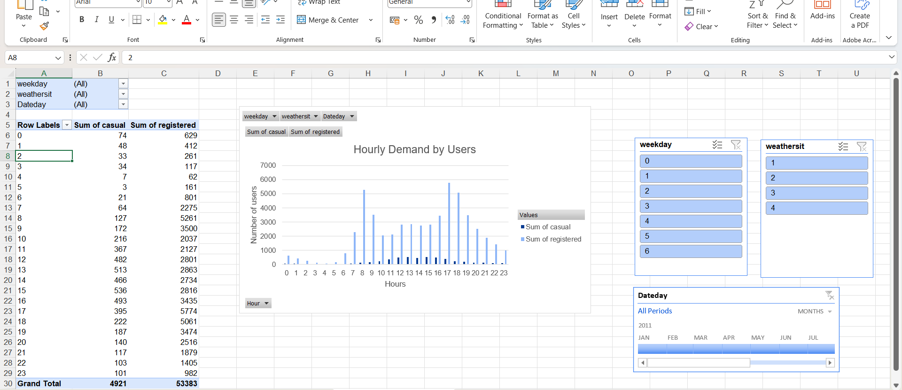
Hourly demand by users
It shows the number of casual and registered users who book the bike in the hours given
Registered users take rentals and peak hours whereas casual users take rentals from 12-2 pm

Slide 11
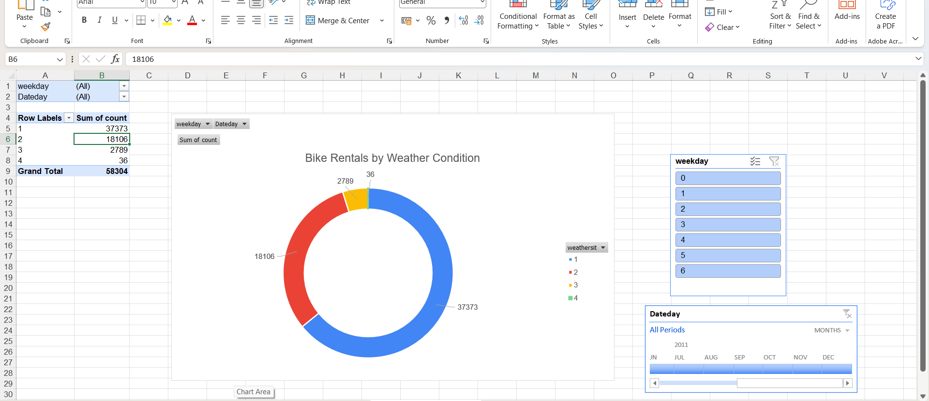
Weathersit vs Count
Number of rentals by weather type
Most rentals occur in clear weather
Severe weather”4” significantly reduces rentals

Slide 12
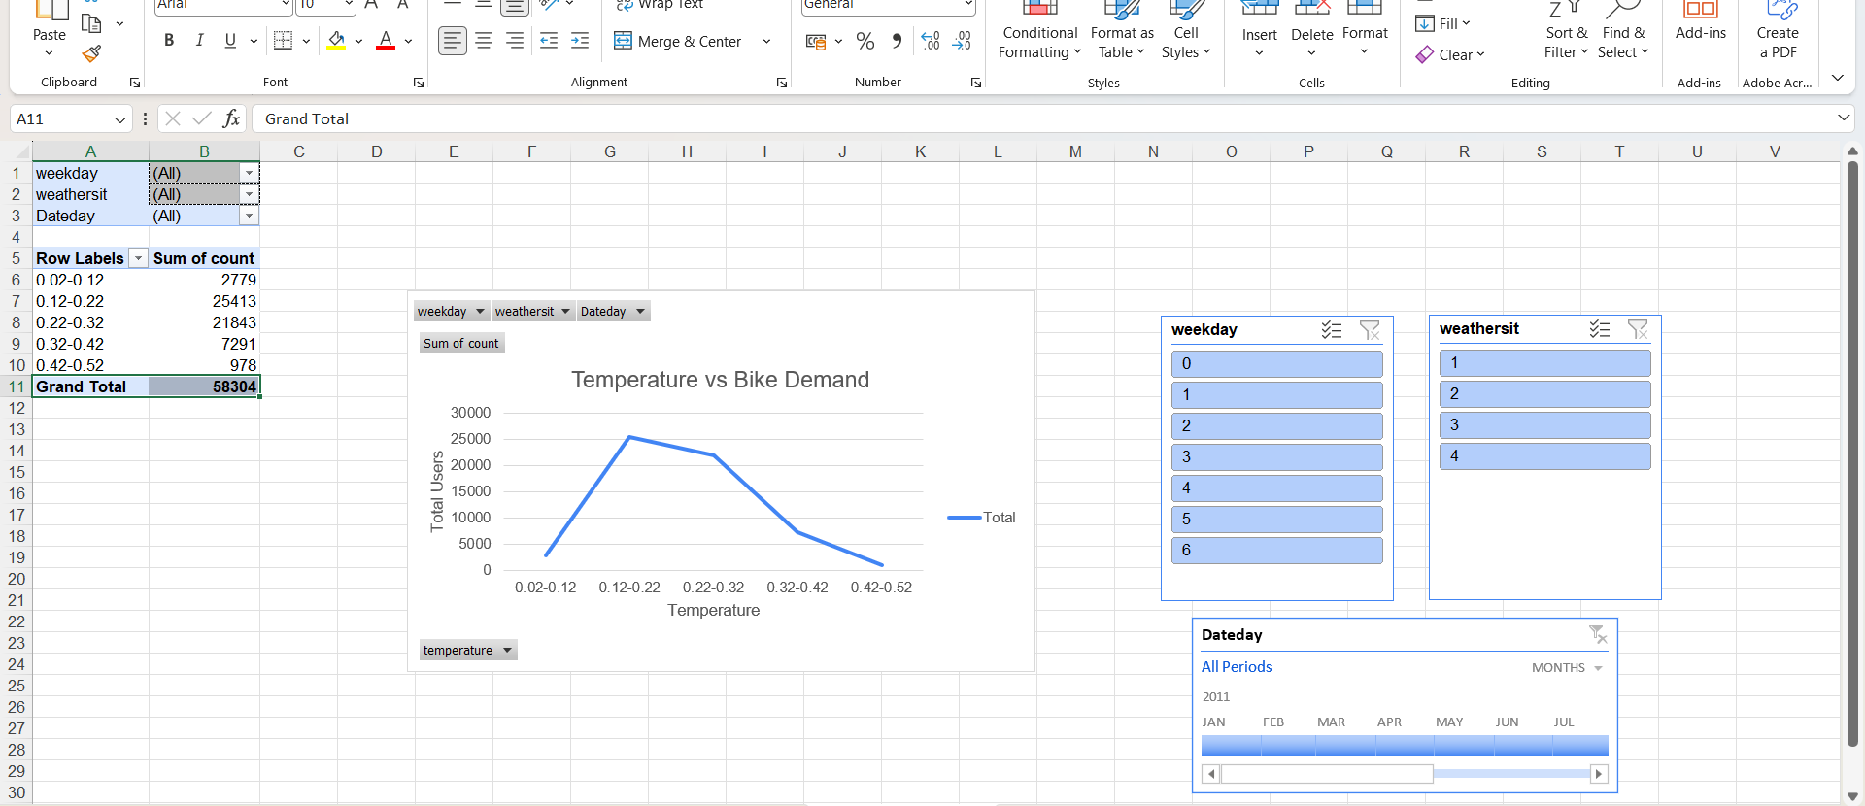
Temperature vs count
Rentals grouped by temperature
Rental increases with moderate temperature and drop in extreme cold or heat

Slide 13
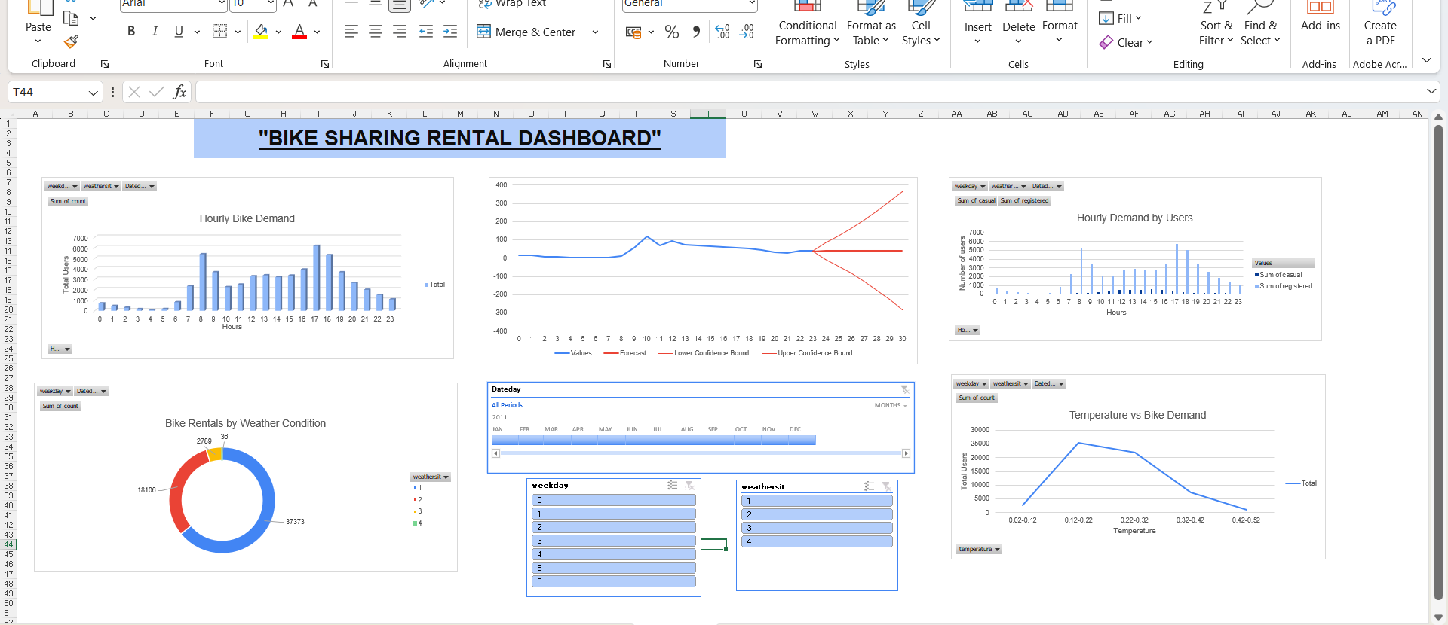
Dashboard overview
All charts combined in one interactive view with slicers and timeline
The dashboard allows filtering by weekday , weather and date
Charts update dynamically to show real time trends

Slide 14
Data Visualization and Dashboard
Built interactive dashboard with 4 main charts
Added slicers for weekday and weather and timeline for data filtering
Forecast charts for hourly rentals

Slide 15
Business Recommendation
Allocate bike during peak hours
Increase availability during clear weather
Monitor anomalies to adjust operations dynamically
Forecast help to plan inventory and staffing

Slide 16
Thankyou
Name: Swati Maurya
Email Id: mauryaswati1016@gmail.com

